Slide 1
K-NN(Nearest Neighbor)

Slide 2
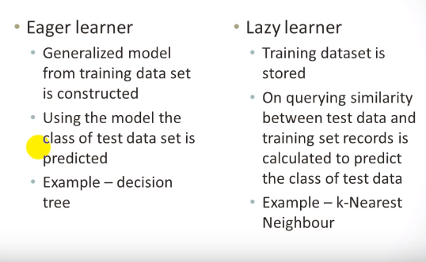
Eager vs Lazy Learners

Slide 3
K-NN
K-Nearest Neighbor is considered a lazy learning algorithm that classifies data sets based on their similarity with neighbors.
Non-parametric method used for classification
Prediction for test data is done on the basis of its neighbor
K is an integer, If k=1, K is assigned to the class of single nearest neighbor
The processing defers with respect to K value.
Result is generated after analysis of stored data.

Slide 4
WHY NEAREST NEIGHBOR?
Used to classify objects based on closest training examples in the feature space
Feature space: raw data transformed into sample vectors of fixed length using feature extraction (Training Data)
Top 10 Data Mining Algorithm
ICDM paper – December 2007
Among the simplest of all Data Mining Algorithms
Classification Method
Implementation of lazy learner
All computation deferred until classification

Slide 5
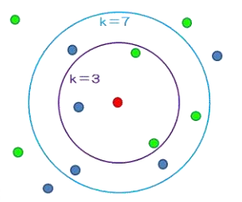
K- NEAREST NEIGHBOR
Requires 3 things:
Feature Space(Training Data)
Distance metric
to compute distance between records
The value of k
the number of nearest neighbors to retrieve from which to get majority class
To classify an unknown record:
Compute distance to other training records
Identify k nearest neighbors
Use class labels of nearest neighbors to determine the class label of unknown record

Slide 6
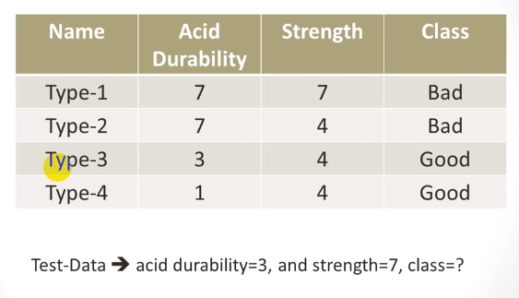
Example

Slide 7
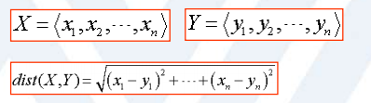
Similarity Measure (Euclidean distance)
Ex: Given X = {-2,2} & Y = {2,5} Euclidean Distance = dist(X,Y) = [ (-2-2)^2 + (2-5)^2 ]^(1/2) = dist(X,Y) = (16 + 9)^(1/2) = dist(X,Y) = 5

Slide 8
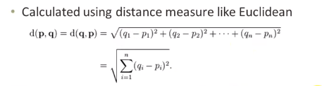
Similarity Measure (Euclidean distance)

Slide 9
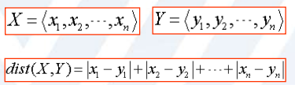
Similarity Measure (Manhattan Distance)
Ex: Given X = {1, 2} & Y = {2, 5} Manhattan Distance = dist(X,Y) = |1-2|+|2-5| = 1+3= 4

Slide 10
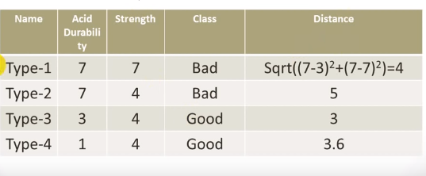
Similarity Calculation

Slide 11
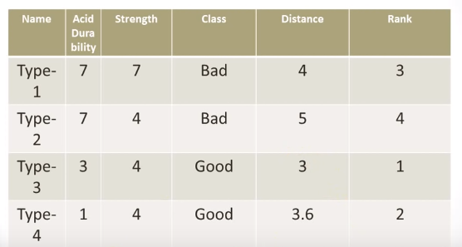
Rank these Attributes

Slide 12
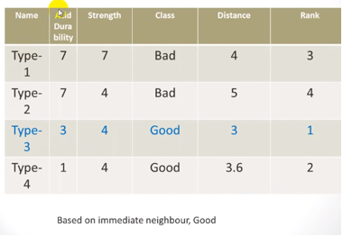
K=1

Slide 13
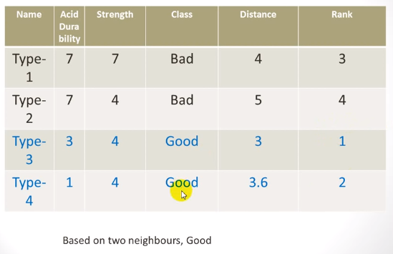
K=2

Slide 14
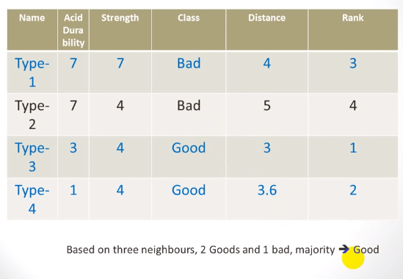
K=3

Slide 15
Advantages
Can be applied to the data from any distribution for example, data does not have to be separable with a linear boundary
Simple technique that is easily implemented
Good classification if the number of samples is large enough
Building model is inexpensive
Extremely flexible classification scheme
does not involve preprocessing

Slide 16
Disadvantages
Dependent on K Value
Test stage is computationally expensive
No training stage, all the work is done during the test stage
This is actually the opposite of what we want. Usually we can afford training step to take a long time, but we want fast test step
Need large number of samples for accuracy
Classifying unknown records are relatively expensive
Requires distance computation of k-nearest neighbors
Computationally intensive, especially when the size of the training set grows
Accuracy can be severely degraded by the presence of noisy or irrelevant features

Slide 17
Reference
https://www.youtube.com/watch?v=2YQHPfwVuF8

